Slide 1
Assessing the impact of prior knowledge and Moodle activities in programming courses by data and text mining
Department of Informatics, University of Rijeka
Radmile Matejčić 2, 51000 Rijeka, Croatia
http://www.inf.uniri.hr
Sabina Šišović, Research and Teaching assistant
ssisovic@inf.uniri.hr
Maja Matetić, PhD, Associate Professor
majam@inf.uniri.hr
Marija Brkić Bakarić, PhD, Higher Teaching Assistant
mbrkic@inf.uniri.hr

Slide 2
Introduction
this research consists of three parts and each concerns different programming course and it’s issues, but with the related objectives:
  Find possible impacts on a detected increase in the passing rate in Programming 1 course, by examining Moodle data and prior knowledge
  Examine the influence of self-assessments and video lectures, as supportive activities, on the learning performance in comparison with the graded elements in Programming 2 course
  Analyse student reports in order to find useful knowledge and to verify their predictive power on success in course Algorithms and Data Structures

Slide 3
Mining student data to assess the impact of Moodle activities and prior knowledge on programming 1 course success
Association rule mining of introductory programming 2 course activities
Text mining student reports in course Algorithms and Data Structures

Slide 4
Passing rate in Programming 1
Mining student data to assess the impact of Moodle activities and prior knowledge on programming course success

Slide 5
Dataset
Mining student data to assess the impact of Moodle activities and prior knowledge on programming course success
153 instances, 10 attributes:
  class attribute: Pass Y/N
Related to Moodle activity | Related to prior knowledge
Course views | Preparatory seminar Y/N
Assignment views | Mathematics level
Assignment uploads | Mathematics result
Resource views | Informatics result
Forum views

Slide 6
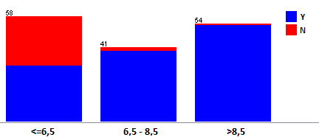
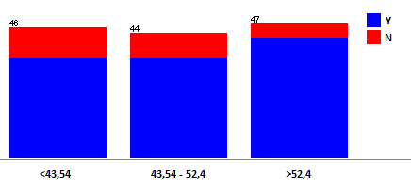
Visualization
Mining student data to assess the impact of Moodle activities and prior knowledge on programming course success
Distribution of students passing (Y) / failing (N) the course in the feature AssignmentUploads
Distribution of students passing (Y) / failing (N) the course in the feature MathResult

Slide 7
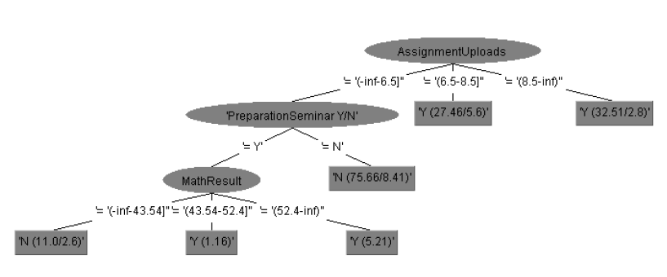
J48 – decision tree
Mining student data to assess the impact of Moodle activities and prior knowledge on programming course success
upload of assignments is the most important feature
students who do not attend the preparatory seminar do not pass the course
for those who attend the preparatory seminar, the Matura exam result in Mathematics is crucial
*representativity of the rules at this level of the tree is quite low

Slide 8
JRip – set of rules
Mining student data to assess the impact of Moodle activities and prior knowledge on programming course success
  students who attend the seminar pass the course
  students who upload a large number of assignments pass the course
  middle value of AssignmentUploads and InformaticsResult of lowest value leads to “pass”
  everything else - “fail”

Slide 9
PART – set of rules
Mining student data to assess the impact of Moodle activities and prior knowledge on programming course success
students with high and middle values of assignment uploads and course views, and attending the seminar pass the course
students who miss preparatory seminar and have low upload activity do not pass the course
students with the highest MathResult pass the course
(low representativity)

Slide 10
Mining student data to assess the impact of Moodle activities and prior knowledge on programming 1 course success
Association rule mining of introductory programming 2 course activities
Text mining student reports in course Algorithms and Data Structures

Slide 11
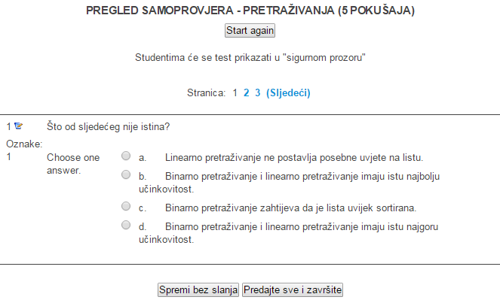
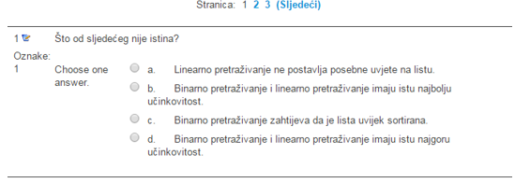
Supportive activity: Self-assessments
Association rule mining of introductory programming 2 course activities
Screenshot from the self-assesment activity “Search-algorithms”

Slide 12
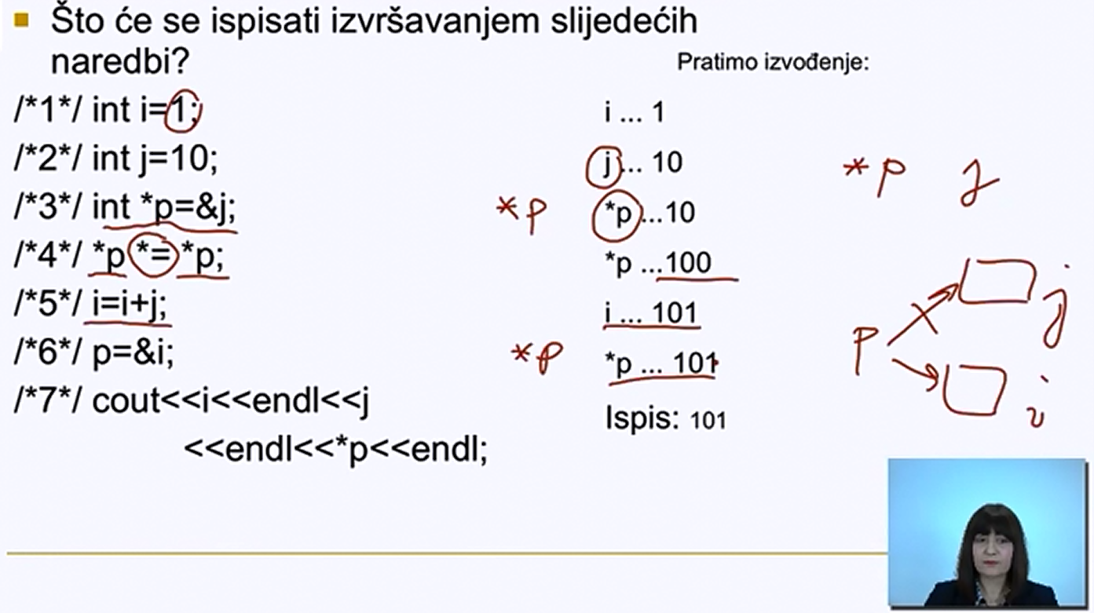

Supportive activity: Video lectures
Association rule mining of introductory programming 2 course activities
Screenshot from the video lecture “Introduction to pointers”

Slide 13
Dataset and experiment
Association rule mining of introductory programming 2 course activities
Lectures | Quizzes | Labs | Videos | Self-assessments | Grade
Gained points | Gained points | Gained points | No. of clicks | No. of clicks | Final mark the student obtained in the course
Grade distribution:
A | B | C | D | E | F
4 | 6 | 12 | 14 | 16 | 25
Grade attribute transformation:
GOOD | PASS | FAIL
22 | 30 | 25
we used Association rule mining based on the Apriori method, to discover connections between selected activities and students’ final grades

Slide 14
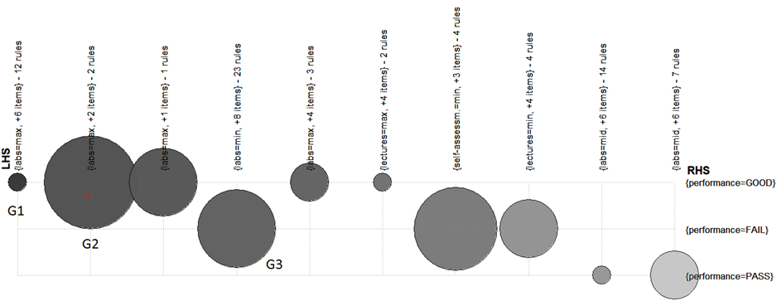
Results: Group rules matrix
Association rule mining of introductory programming 2 course activities
inspect
zoom in
zoom out
end

Slide 15
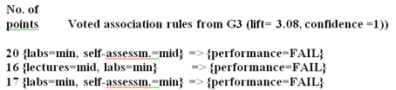
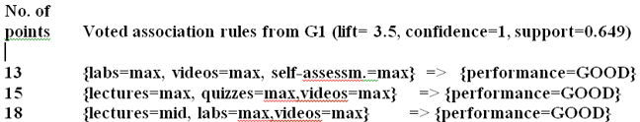
Results: Voted rules
Association rule mining and visualization of introductory programming 2 course activities
“videos=max”- antecedent ➔ “performance=GOOD” as consequence
“videos=min” - antecedent ➔ “performance=FAIL” as consequence (except 1 rule)
self-assessment - not a decisive factor
  antecedent “self assessm.=min” is the most common for the consequence “performance=FAIL”

Slide 16
Mining student data to assess the impact of Moodle activities and prior knowledge on programming 1 course success
Association rule mining and visualization of introductory programming 2 course activities
Text mining student reports in course Algorithms and Data Structures

Slide 17
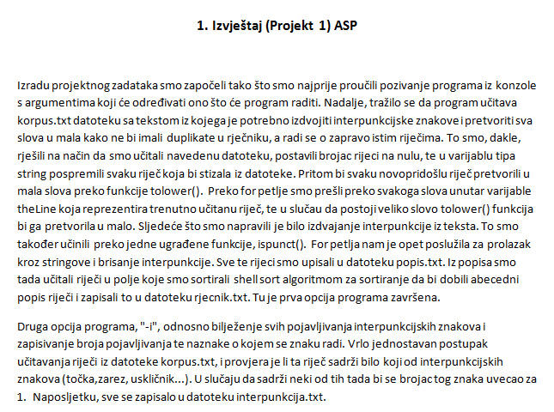
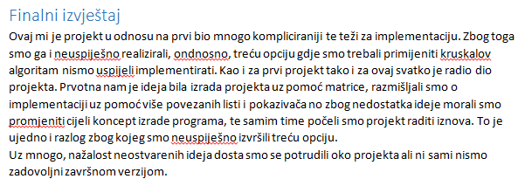
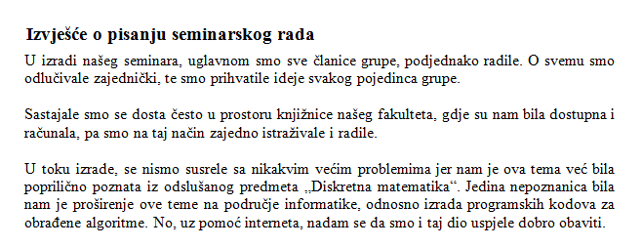
Student reports
Text mining student reports in course Algorithms and Data Structures
Informatics students: two mid-reports per group + one final per each member
Mathematics students: only final report (seminar) per each member of the group
Form was not prescribed

Slide 18
Experiment and results
Text mining student reports in course Algorithms and Data Structures
Descriptive statistical analysis
Frequency word analysis
  Word „problem” is present in all top words except for grade A
  in mid-reports – 3/10 top words are C++ keywords
report length and grades or type of report | No significant correlation
the scores obtained on each project individually and the final grade | STRONG POSITIVE
the score obtained on seminar and the final grade | MODERATE POSITIVE

Slide 19
Experiment and results
Text mining student reports in course Algorithms and Data Structures
Contrastive analysis
  highest grades show focus on the very assignment
  B, C, D – more focused on solving problems
  F – no particularities and even do not tackle concrete problem
Classification
  New discretization of grades: PASS/FAIL
  The highest accuracy obtained with classifier SVM
  Big number of features – better results with feature selection

Slide 20
Final conclusions
we confirmed that Moodle activities are better predictors of final success than the Matura examination results, but preparatory seminar also contributes to the course success
we are motivated to make some more video lectures, because of the high connection between watching video lectures and passing and failing the course
self-assessment activity is obviously not a decisive factor for student success, but there is a connection between low self assessment activity and failing the course
we confirmed our intuitive assumptions about report quality in relation to the course success, but their length has no predictive power

Slide 21

Assessing the impact of prior knowledge and Moodle activities in programming courses by data and text mining
Department of Informatics, University of Rijeka
Radmile Matejčić 2, 51000 Rijeka, Croatia
http://www.inf.uniri.hr
Thank You for your attention!
Sabina Šišović, Research and Teaching assistant
ssisovic@inf.uniri.hr
Maja Matetić, PhD, Associate Professor
majam@inf.uniri.hr
Marija Brkić Bakarić, PhD, Higher Teaching Assistant
mbrkic@inf.uniri.hr

